Slide 1

Searching colors around you!
Chun-Kai Wang & Partrick Lee
2017.06.22

Slide 2
Outline
UI
Complexity
Member contribution

Slide 3
UI

Slide 4
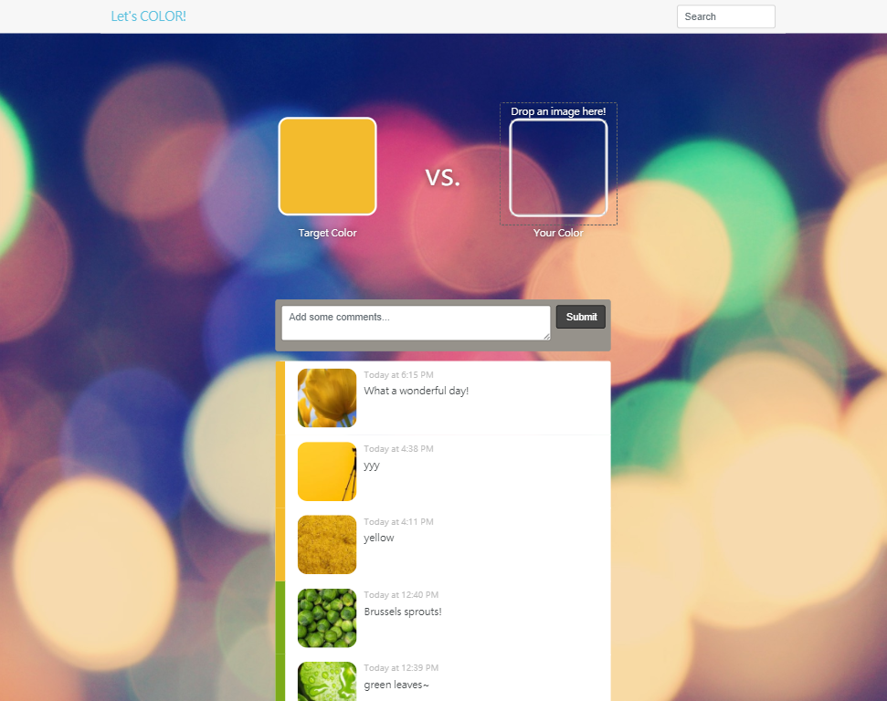
Front page

Slide 5
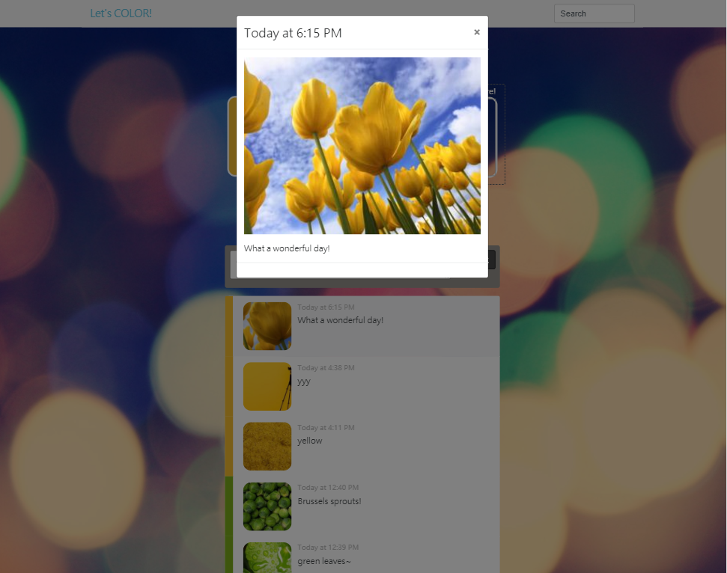
Modal

Slide 6
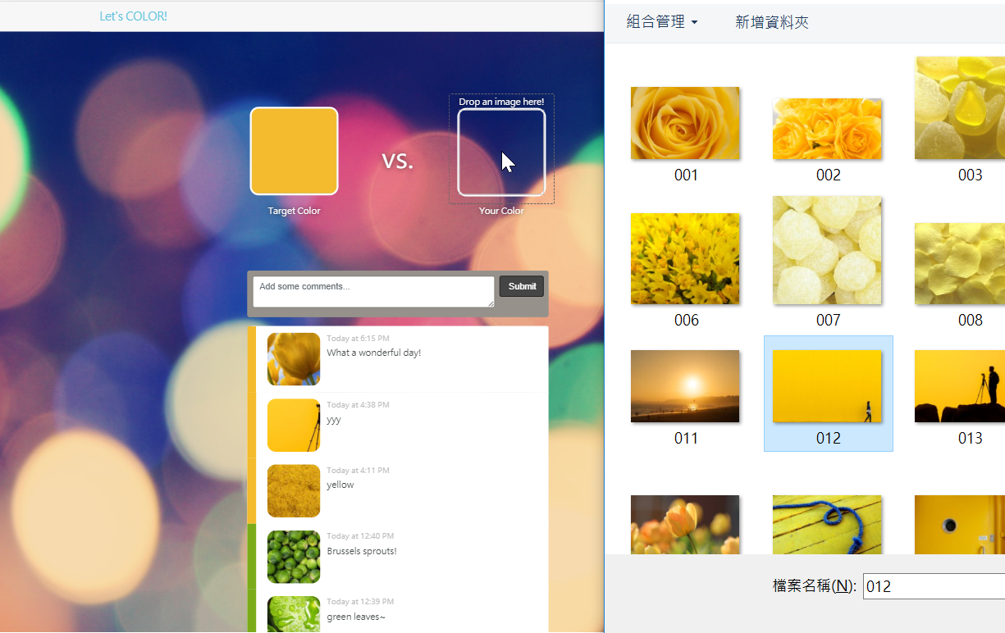
Image upload

Slide 7
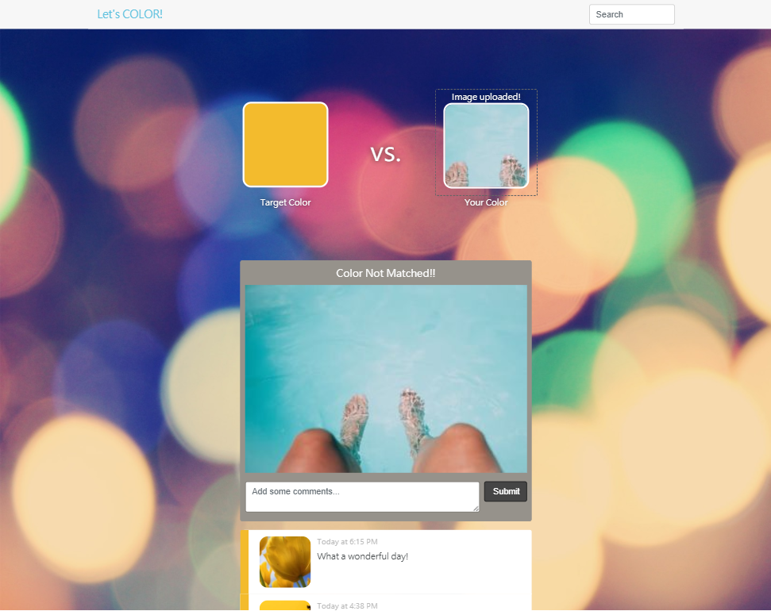
Color not matched. Try another one!

Slide 8
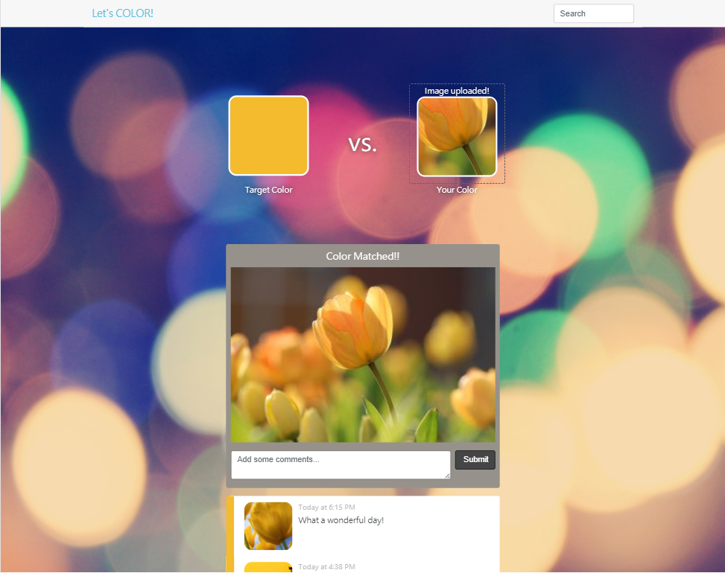
Color matched! You can share with your friends.

Slide 9
Layout and elements

Slide 10
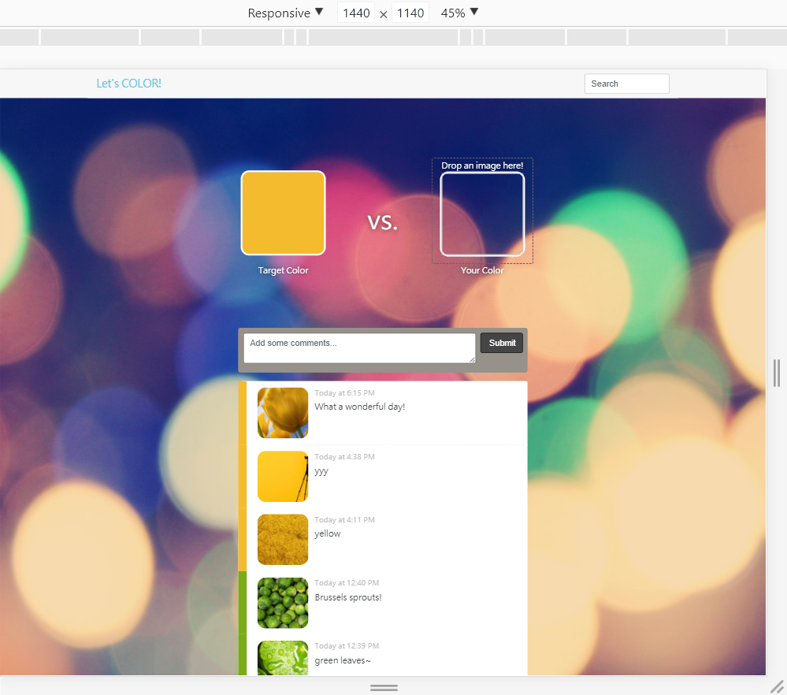
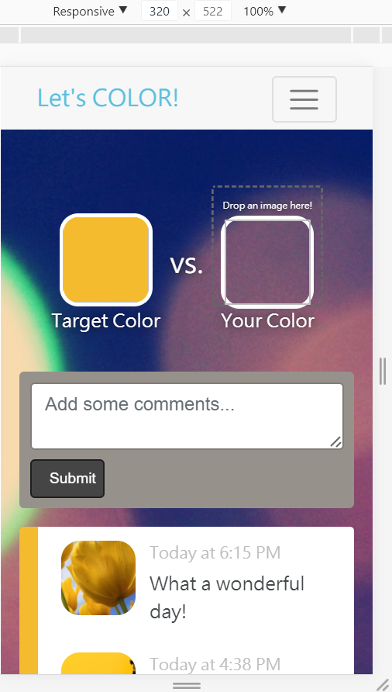
Responsiveness
xl
xs

Slide 11
Complexity

Slide 12
Complexity
Image upload and processing
Image download
Average color calculation
Daily random target color generation

Slide 13
Image upload
react-dropzone
cloudinary
https://css-tricks.com/image-upload-manipulation-react/

Slide 14
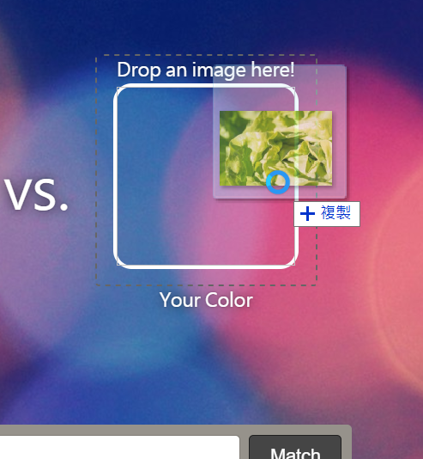
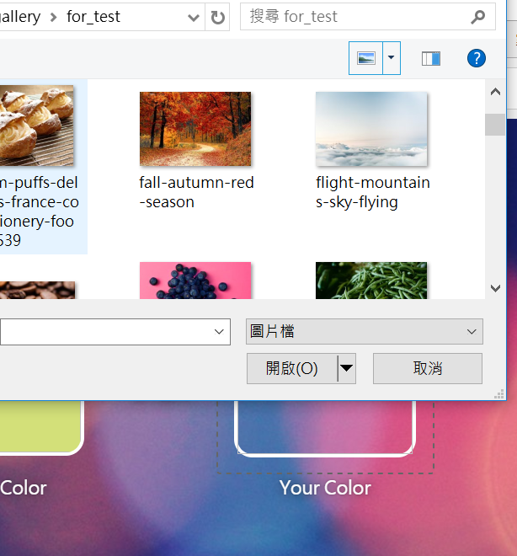
react-dropzone
Drag & Drop
Click & Upload

Slide 15
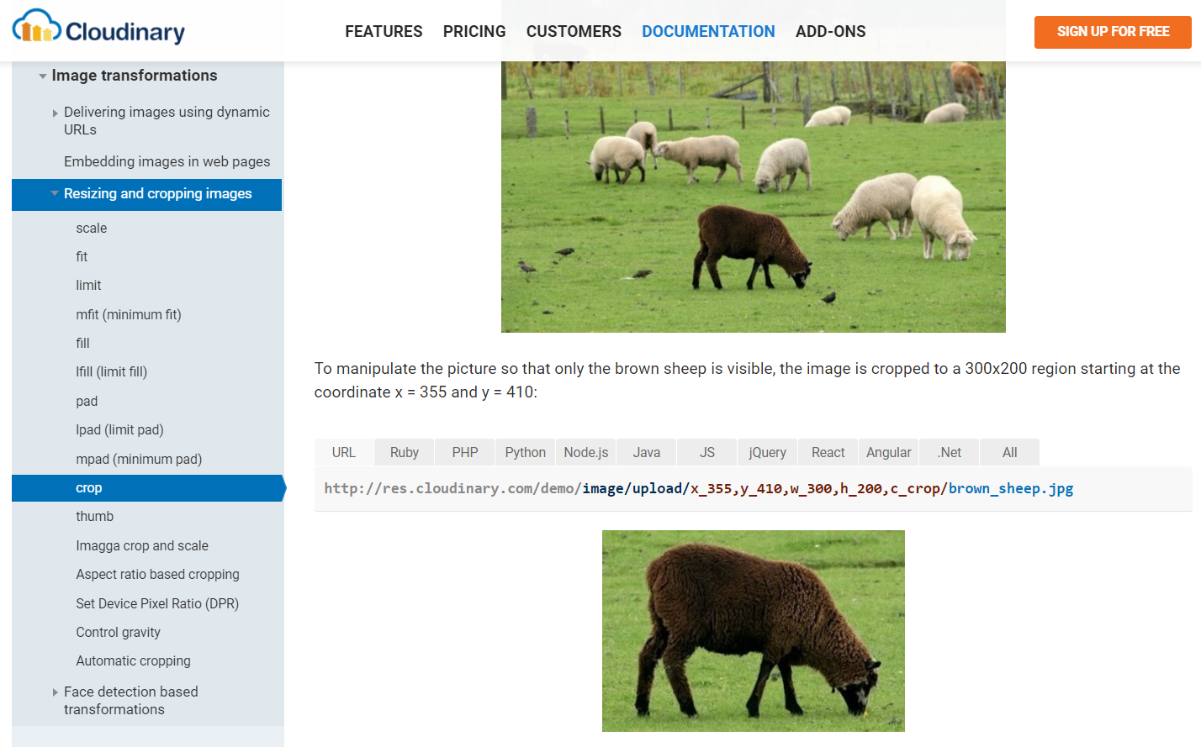
Cloudinary
Manipulation
Storage
Return url
Free account
http://cloudinary.com/documentation/image_transformations#crop

Slide 16
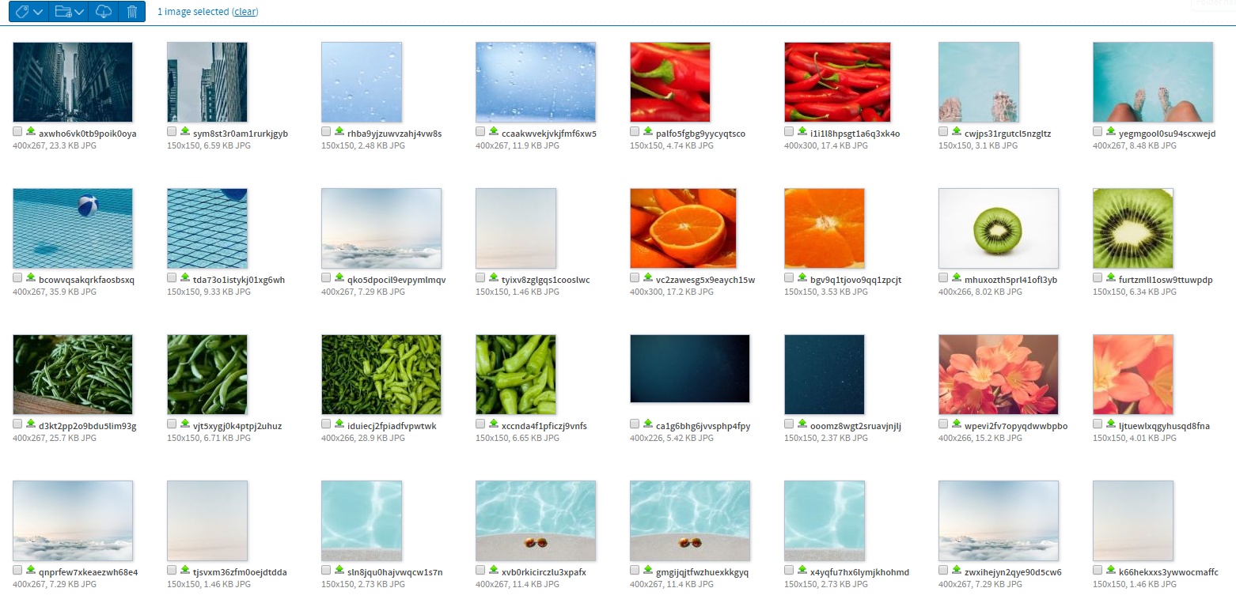
Cloudinary
Storage
http://cloudinary.com/documentation/image_transformations#crop

Slide 17
Average color calculation
npm download file
npm image-average-color
npm delete file

Slide 18
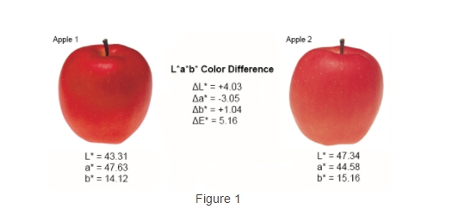
Color Comparison
Use L, a, b rather than R,G,B for color comparison
Approximate to human vision
Determine the difference threshold by visual test
http://sensing.konicaminolta.us/2014/04/identifying-color-differences-using-l-a-b-or-l-c-h-coordinates/
https://en.wikipedia.org/wiki/Lab_color_space

Slide 19
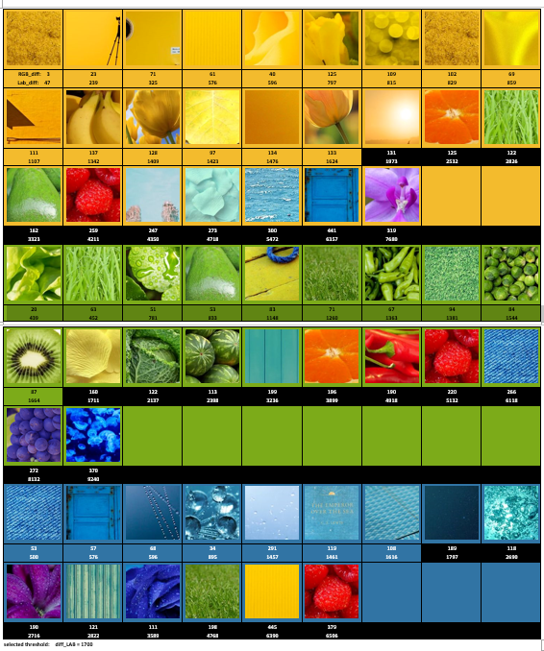
Threshold determination
Threshold value
Threshold formula
D = (dL*1.5 + da*2 + db*2) /4

Slide 20
Member contribution
Chun-Kai Wang
UI and front-end
Image upload and connection to “Cloudinary” API
Post functions (client)
AWS deployment
Patrick Lee
Post functions (server)
Image download
Computation of image average color
Random color generation

